Slide 1
2 Graphics
3 h
Hein Stigum & Jonathan Wörn
Presentation, data and programs at:
https://tinyurl.com/53scv867

Slide 2
This Course
Date | Level | Topic | Teacher
21.1. | Beginner | Introduction to Stata | JW
28.2. | Beginner | Graphics for data and results | JW
7.3. | Elementary | Linear Regression | HS
14.3. | Elementary | Logistic regression | HS
21.3. | --------------- No course --------------- | Survival analysis | HS
28.3. | Advanced | Survival analysis | HS
4.4. | Advanced | Automating analysis: Loops, macros, … | HS
11.4. | Advanced | Programing: Simulating data, bootstrapping, power calculations | HS
18.4. | Advanced | Individual fixed effects regression | JW
For more details: https://tinyurl.com/53scv867
2

Slide 3
Today’s menu
Recap Introduction
twoway plots (individual/raw data)
Plots for summary measures
Plots of regression results

Slide 4
Recap: Introduction

Slide 5
Files, data, description
.dta – .do – .smcl/.log – cntr+D
use – import – save
describe – list – summarize – tabulate – tabstat

Slide 6
Variables and help
generate – replace – recode
missings = . – mvdecode – misstable – tab var, m
help command – https://www.stata.com/links/resources-for-learning-stata/ (cheatsheets, annotated output and more)

Slide 7
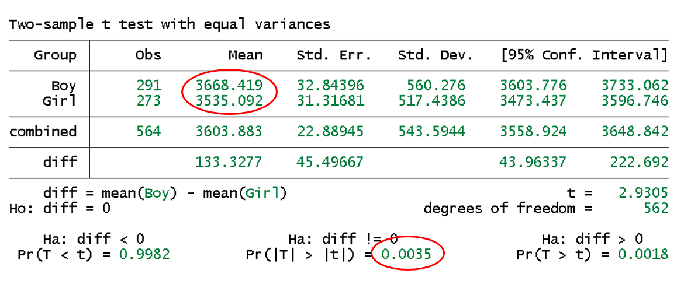
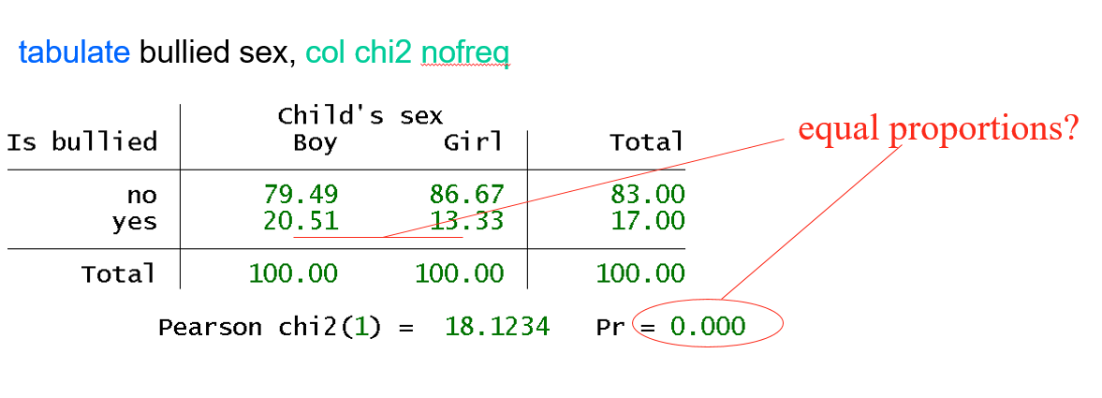
Bivariate analyses
ttest
tabulate

Slide 8
Twoway plots
Syntax
  twoway (plot1, opts) (plot2, opts), opts
One plot
  kdensity bw
  scatter bw gest
8
Notes:
Show distributions, density best
Area scales to 1, can compare groups of different size.

Slide 9
Plots & plot types

Slide 10
Why plots?
For yourself:
  Getting to know data before/during analyses
For others:
  Graphical display of your results
Notes:
Purpose of todays meeting:
Show some types of plots
Show how to get them
Show how to adjust them to your needs/wishes
Having said this: abundance of options, thus: exemplary, and hopefully enabling for own work!

Slide 11
Plot types
Twoway
  Scatter, line
  Density, line-fit, fractional polynomial fit
  Range cap, function
Bar, dot, box
Marginsplots
Coefplots
Pie
Regression diagnostic plots

Slide 12
Plottypes
May overlay twoway plots
Working plots
Presentation plots
Notes:
Plot at start of analysis: scatter, density, box (raw data)
Plot results: bar, dot (derived data)
Pie: poor, parts of a whole
Main difference: twoway plots raw data, the others plots summaries of data (means, medians, …)

Slide 13
Making plots
Making plots (2 ways)
  Menu
  Syntax
Editing plots, graph Editor
  In a graph: File → Start Graph Editor

Slide 14
Twoway Plots
Plots of raw data

Slide 15
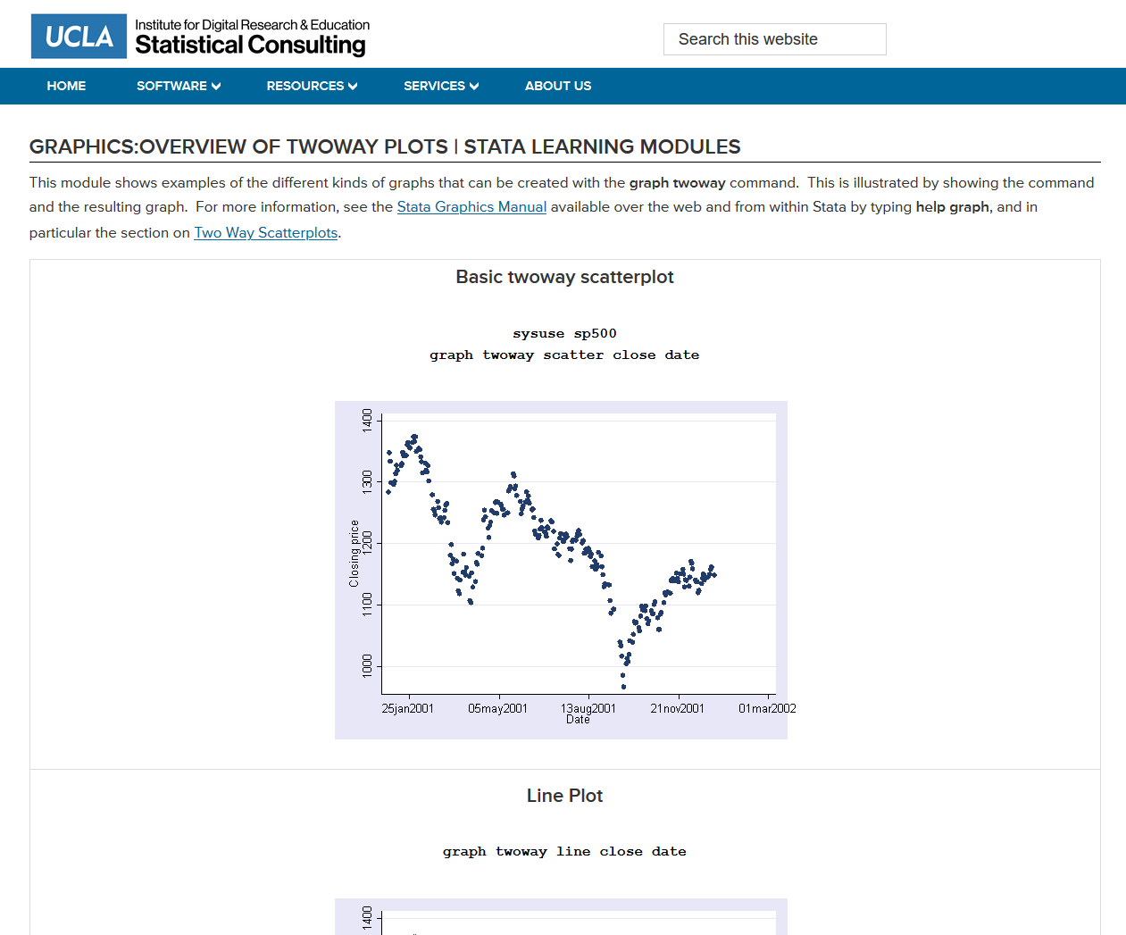
Overview of twoway plots
https://stats.idre.ucla.edu/stata/modules/graph8/twoway/

Slide 16
Twoway density
Syntax
  graph twoway (plot1, opts) (plot2, opts), opts
One plot
  kdensity bw
line:
navy, solid
Notes:
Show distributions, density best
Area scales to 1, can compare groups of different size.

Slide 17
Twoway options, lines
Syntax
  graph twoway (plot1, opts) (plot2, opts), opts
Options
  lcolor(red) line color
  lpattern(“.#-”) line pattern
  lwidth(*2) line width *2

Slide 18
Density overlaid
tw (kdensity bw if sex==0, lcolor(blue) lpattern(solid) ) ///
(kdensity bw if sex==1, lcolor(red ) lpattern(dash) )
legend
legend label 1
legend label 2

Slide 19
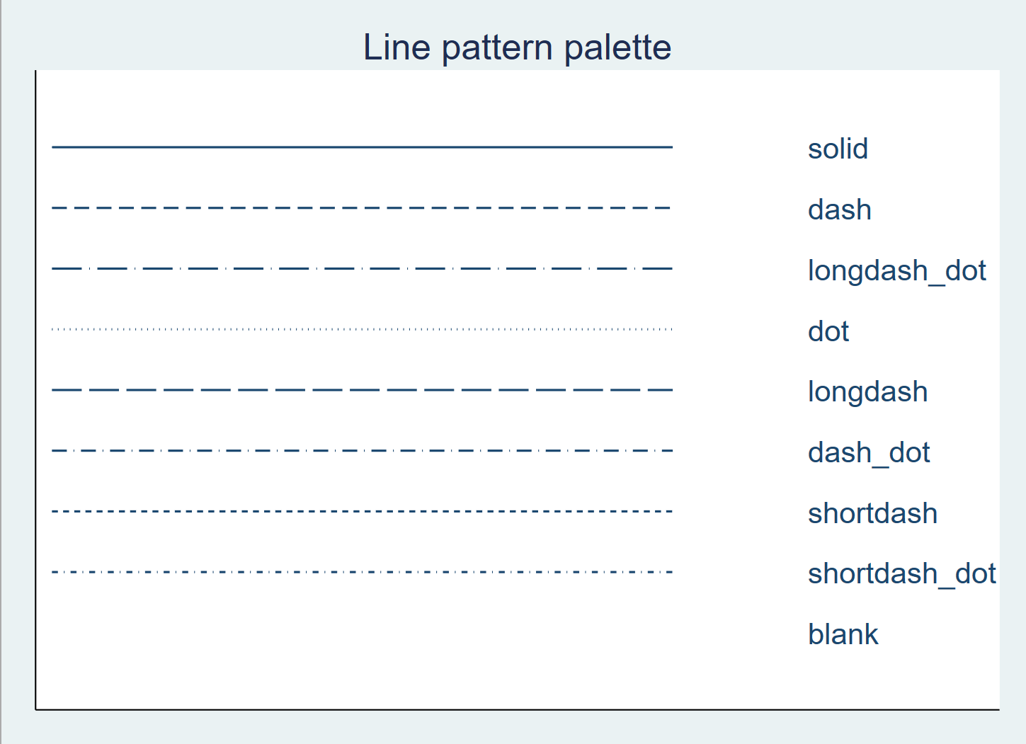
Standard line types
Notes:
Colors, linewidth: check graph editor

Slide 20
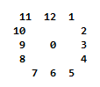
Twoway options, legend
Syntax
  graph twoway (plot1, opts) (plot2, opts), opts
Options
  legend(
    order(1 2) which labels appear & their order
    label(1 “text”) legend label plot 1
    label(2 “text”) legend label plot 2
    ring(0) legend inside plot
    pos(2) legend at 2 o’clock position
    col(1) legends in 1 column
    )
  legend(off) no legend
Notes:
Options for subplots vs. options for whole plot

Slide 21
Legend
tw…, ///
legend(label(1 ”Boys, N=283”) label(2 ”Girls, N=270”) ring(0) pos(11) col(1))

Slide 22
Histogram
twoway (histogram bw), scheme(s1mono)

Slide 23
Histogram
twoway (histogram bw if boy == 0, color(red%50)) /// (histogram bw if boy == 1, color(blue%50)), /// legend(label(1 "girls") label(2 "boys")) scheme(s1mono)

Slide 24
Twoway scatter + fit
Syntax
  twoway || plot1, opts || plot2, opts ||, opts
Examples
  scatter y x scatter
  fpfitci y x smoother (fractional polynomial) with CI
  lfit y x line fit
Notes:
Scatter shows association and outliers

Slide 25
Scatter + smooth + fitline
tw (scatter bw gest) /// /* scatter */
(fpfitci bw gest, clcol(black)) /// /* smoother with CI */
(lfit bw gest, lcol(red )) /// /* fitline */
, legend(off) scale(1.3)
Notes:
clcolor connecting line color
scale ratio text/plot

Slide 26
Twoway scatter options, markers ++
Syntax
  twoway || plot1, opts || plot2, opts ||, opts
Options
  msymbol(S) square marker symbols (S,s,Sh)
  mcolor(red) marker color red
  msize(*0.5) marker size 0.5*default size
  mlabel(id) marker label = variable id
  xline(24) line at x=24
  scale(1.5) all elements 1.5*larger
Notes:
S=Large square, s=small square, Sh=Large square hollow
D=diamond
T=triangle
O=circle

Slide 27
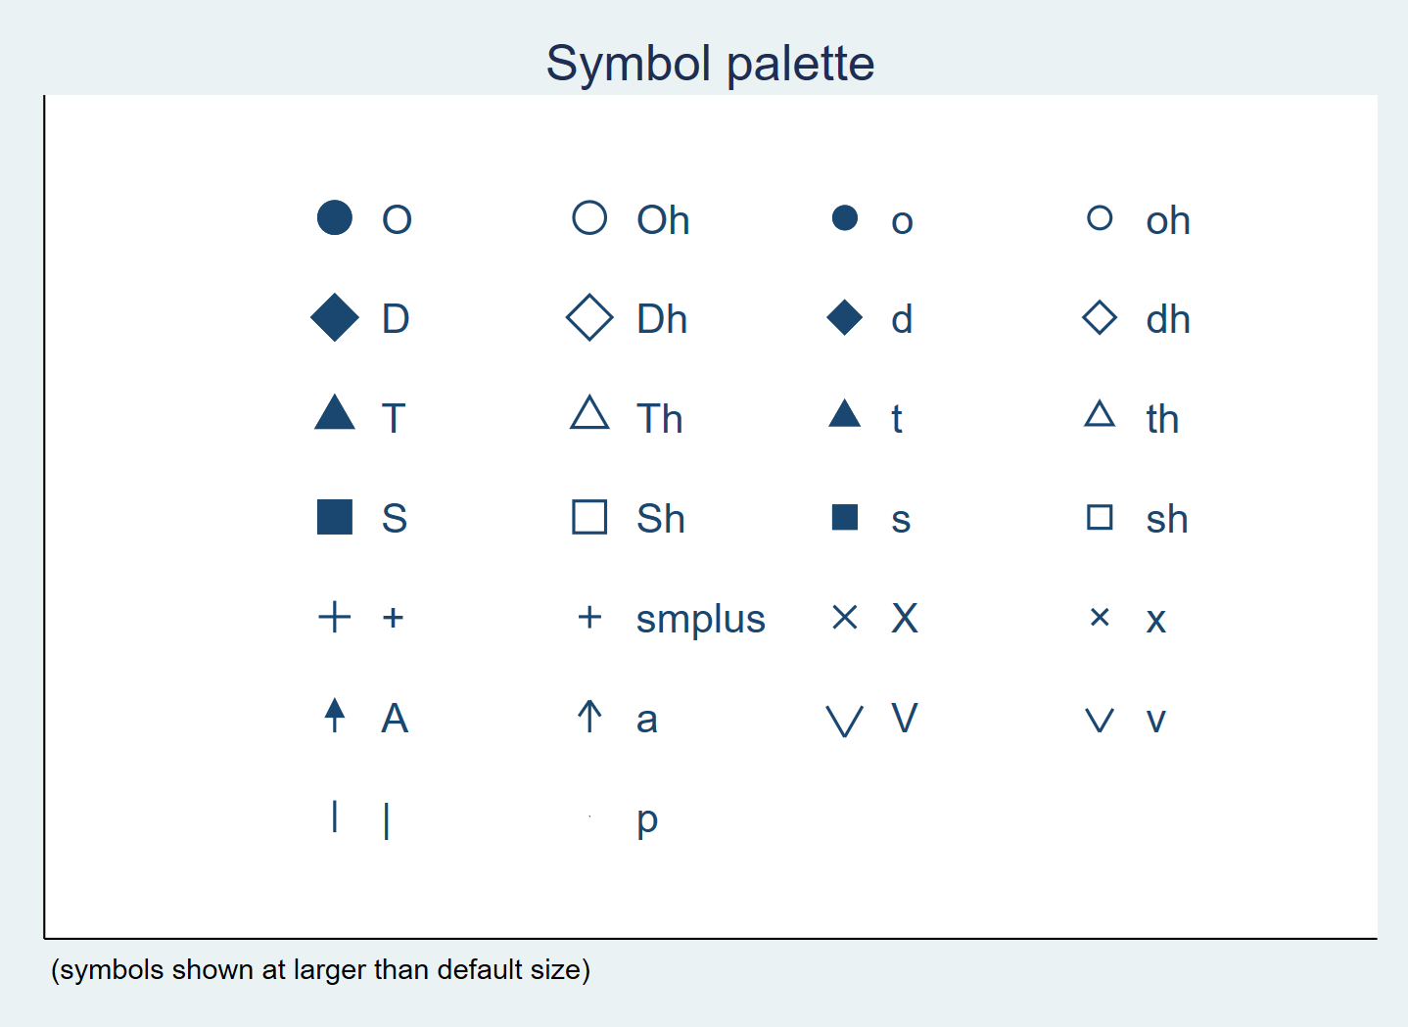
Standard marker symbols

Slide 28
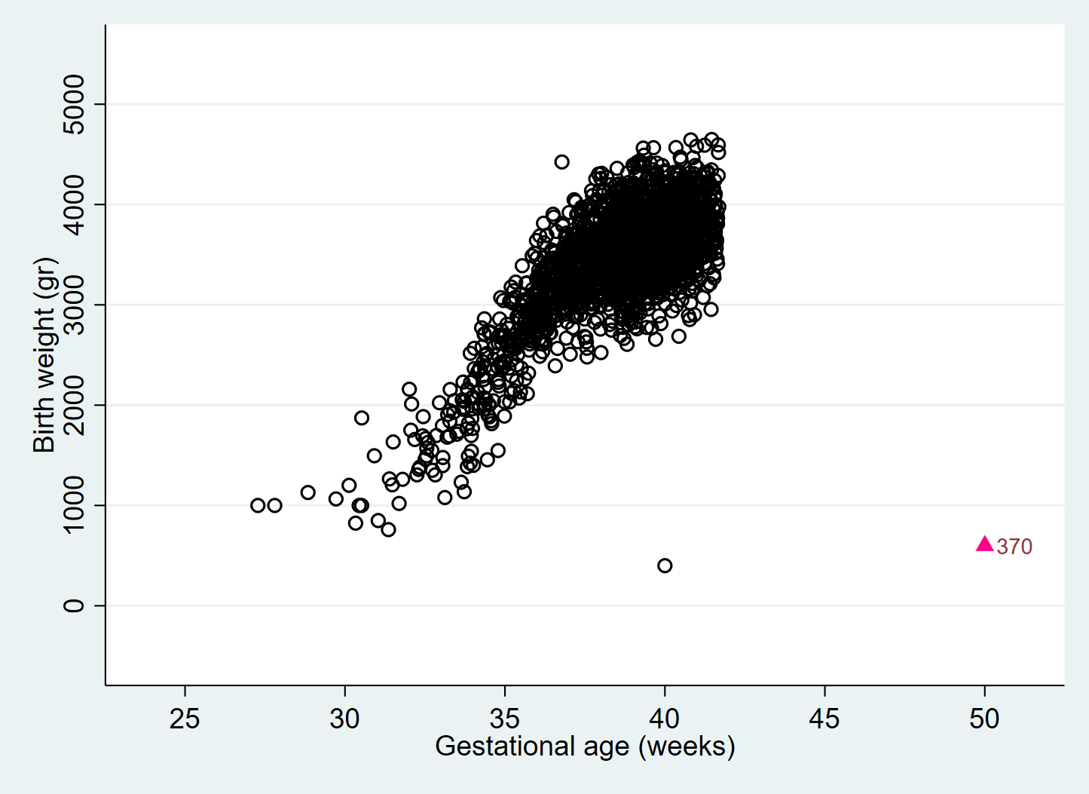
Scatter with outliers marked
tw (scatter bw gest_out if gest < 45, msymbol(Oh) mcolor(black)) ///
(scatter bw gest_out if gest >= 45, msymbol(T) mcolor(pink) mlabel(id)) ///
, legend(off) plotregion(margin(10 10 10 10))
xscale
xlabel
Notes:
Alternative application: using dfbeta instead of graphical inspection of gest to identify outliers (see 2-graphics.do)

Slide 29
Scatter with outliers marked
tw (scatter bw gest_out if gest < 45, msymbol(Oh) mcolor(black)) ///
(scatter bw gest_out if gest >= 45, msymbol(T) mcolor(pink) mlabel(id)) ///
, legend(off) plotregion(margin(10 10 10 10))
Alternative application: using dfbeta instead of
graphical inspection of gest to identify outliers
(see 2-graphics.do)
xscale
xlabel
Notes:
Alternative application: using dfbeta instead of graphical inspection of gest to identify outliers (see 2-graphics.do)

Slide 30
Twoway options, axis options
Syntax
  graph twoway (plot1, opts) (plot2, opts), opts
Options
  xlabel(10(5)100) from 10-100 in steps of 5
  xlabel(#8) appr. 8 “nice” values
  xlabel(minmax 64) min, 64, max
  ylabel(1 2 3, valuelabel) labels of the y-variable (cat)
  yscale(range(0 6)) range from 0 to 6
  yscale(log) log-scale
  xtick(…) ticks and grid

Slide 31
Scatter and scatteri
tabstat bw, stat(mean) by(educ)
tw ||scatter educ bw, ylabel(1 2 3, valuelabel angle(0)) ///
|| scatteri 1 3075 2 3391 3 3638, msymbol(O) msize(*2) mcolor(red) ///
||, legend(off) xtitle("Birth weight") xline(3429) scale(1.3)
Immediate arguments:
scatteri
pci
pcarrowi

Slide 32
Boxplot
graph hbox bw, over(educ)

Slide 33
Boxplot
graph box bw, over(educ)
P75 + 1.5*IQR
Percentile 75
Median
Percentile 25
P25 - 1.5*IQR

Slide 34
Density with mean
sum bw
tw (kdensity bw) ///
, yscale(off) scale(1.5) xtitle("Birth weight") ///
xlabel(minmax 3432, format(%5.0f)) ///
xtick(3432, tposition(cross) tlcol(red) tlwidth(*3) )

Slide 35
As inspiration: density with box info

Slide 36
Twoway, + text
Syntax
  twoway (plot1, opts) (plot2, opts), opts
Options
  text(y x “text”, t_ops) text at (y,x)
    place(0) centered text
    size(*2) text size*2
    color(red) text color
    box box around text
    bcolor(white) background and border color

Slide 37
Function plots with text
function y=f(x), range(0 5)
tw (function y=normalden(x,0,1), range(-4 4) col(red )) ///
(function y=normalden(x,2,2), range(-4 8) col(blue)) ///
, text(0.3 0 "Normal(0,1)" 0.15 2 "Normal(2,2)” box bcol(white))

Slide 38
Plotting Confidence Intervals
twoway ///
(connect weight year, col(blue)) /// means
(rcap ll ul year , col(blue)) 95% CI
input year weight ll ul
2001 60 50 70
2002 75 65 85
2003 75 65 85
end
Notes:
Use margins + marginsplot or coefplot for regression models

Slide 39
Twoway Plots
Plots of summary measures (mean, fractiles, …)

Slide 40
Bar graphs, and alternatives
N=10 000, 4 variables
Nor, Swe and Den: Psycho measures on some continuous scale
Year: 2001 to 2004
graph bar nor swe den, over(year) plotting means
Alternative:
twoway
Works with individual data
Thus requires aggregation of data to means

Slide 41
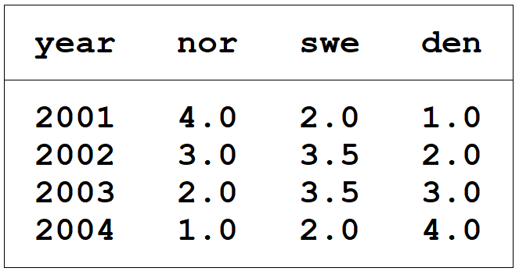
Aggregating data (collapse)
Aggregate
Data after aggregate
Typical use
collapse (mean) nor swe den, by(year)
preserve
collapse (mean) nor swe den, by(year)
…
restore
run together!

Slide 42
Comparing means/prop. better
collapse (mean) nor swe den, by(year) /* aggregate */
tw (connect nor year, col(blue ) msize(*2) ) ///
(connect swe year, col(red ) msize(*2) ) ///
(connect den year, col(green) msize(*2) ) ///
, legend(off) ///
text(3.7 2001.3 "Norway" 2.5 2001.3 "Sweden" 1.3 2001.3 "Denmark", box bcol(white))
Notes:
preserve
…
restore

Slide 43
Comparing means/prop. better

Slide 44
Blood pressure by time and sex, 3 variables
collapse (mean) meanbp=bp, by(sex time)
twoway (scatter meanbp time, connect(ascending))
,yline(140) text(120 3.5 "Males") text(108 5 "Females") legend(off)

Slide 45
MARGINSPLOT & COEFPLOT
Plotting regression results

Slide 46
Prediction from linear regression
regress bw c.gest##sex i.educ // regression model with interaction term
margins sex, at(gest=(30(1)40))
marginsplot, scale(1.2) // predicted birth weight by gest and sex
no
estimated
interaction

Slide 47
Prediction from logistic regression
logistic lbw c.gest##sex i.educ // regression model with interaction term
margins sex, at(gest=(30(1)40))
marginsplot, scale(1.5) // probability of low birth weight by gest and sex

Slide 48
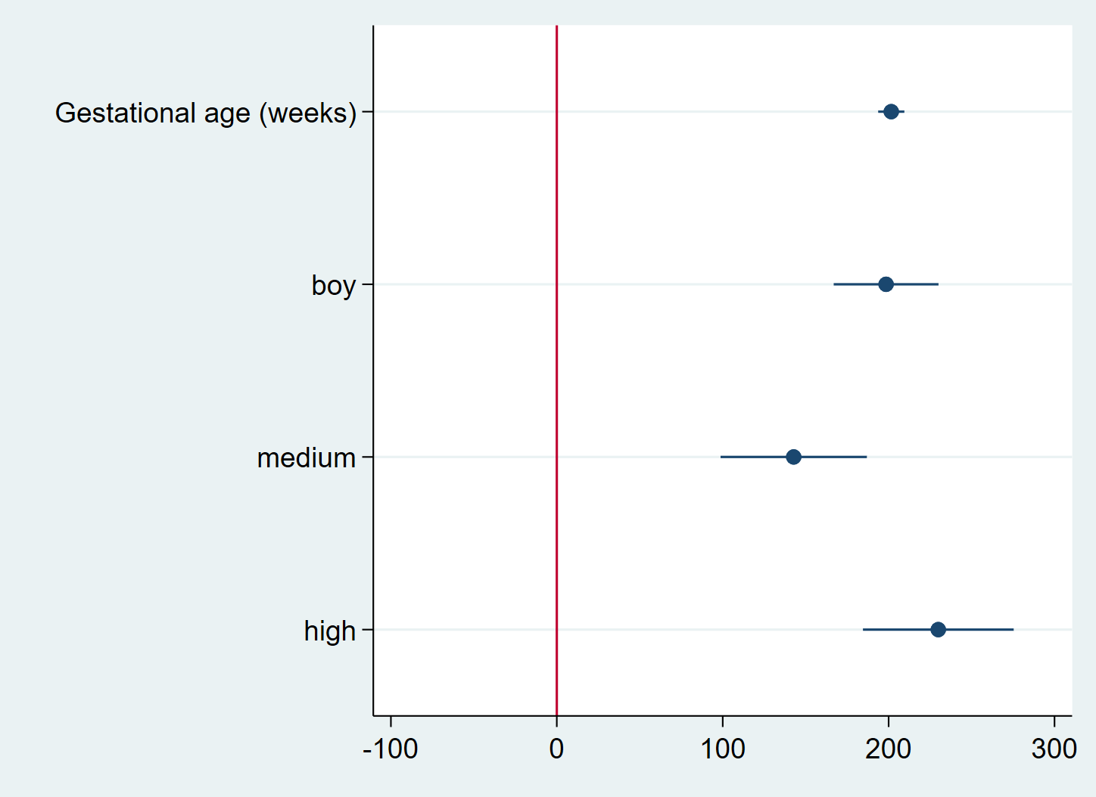
Coefplot
regress bw c.gest boy i.educ // regression model
coefplot, drop(_cons) xline(0) xlabel(-100(100)300)
// Coefficient plot without constant and
// with xline at 0 and defined x-labels

Slide 49
SCHEMES

Slide 50
Nicer graphics using schemes
set scheme s2color /* default */
set scheme s1mono /* monochrome */
“schemes”

Slide 51
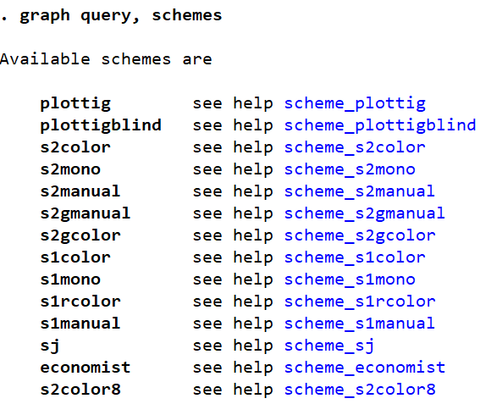
Nicer graphics using schemes
Schemes:
Predefined preferences specifying look of graphs
Finding schemes
installed on computer:
graph query, schemes
Adding new schemes:
ssc install schemename
e.g. blindschemes,
schemepack

Slide 52
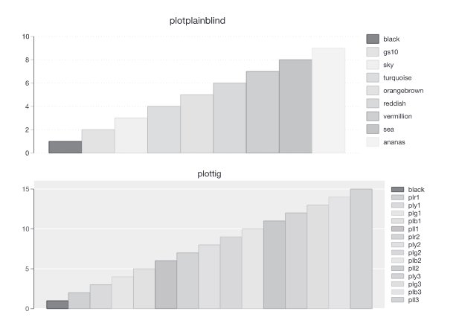
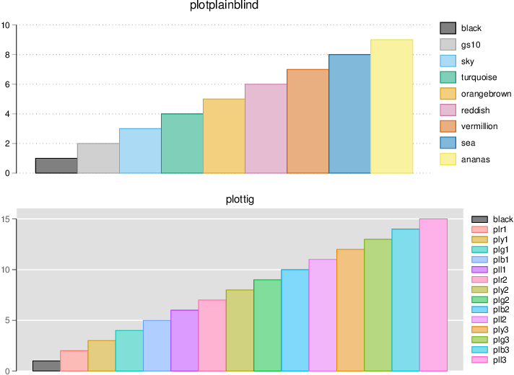
Nicer graphics using schemes
plotplainblind: distinguishable for colorblind viewers
set scheme plotplainblind
or: twoway …, scheme(plotplainblind)
https://journals.sagepub.com/doi/pdf/10.1177/1536867X1701700313
https://www.stata.com/meeting/switzerland16/slides/bischof-switzerland16.pdf

Slide 53
Keeping graphs in window

Slide 54
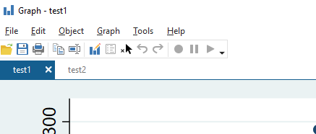
Keep plots during session
Set “tabbed” graphics
Give each plot a name
set autotabgraphs on, permanently
twoway …, name(“scatter”,replace)

