Slide 1
Stata:
Flexible Parametric Survival models
3h
Hein Stigum
Presentation, data and programs at:
Stata Course - Institutt for helse og samfunn (uio.no)

Slide 2
Syntax files and Datasets
5.0 Flexible Parametric Survival Course, Downloads
  List of programs to install
5.0 Cox model
5.1 Flexible Parametric Survival
Datasets
  melanoma
  kidney_ca
  ew_breast_alldep_ch7
On the homepage

Slide 3
Agenda
Standard Survival analysis
  Hazards, Survival, Hazard Ratios
  Cox model, Limitations
Flexible Parametric Survival Models
  Splines
  Model syntax
  Predict syntax

Slide 4
Agenda cont.
Assumptions of the standard model
  Proportional Hazards
  Linear dose response
  No interactions
  Non-informative censoring
Problems with the Hazard Ratio
Alternatives to the Hazard Ratio
  Restricted Mean Survival Time (Difference)
  Standardized Survival Curves

Slide 5
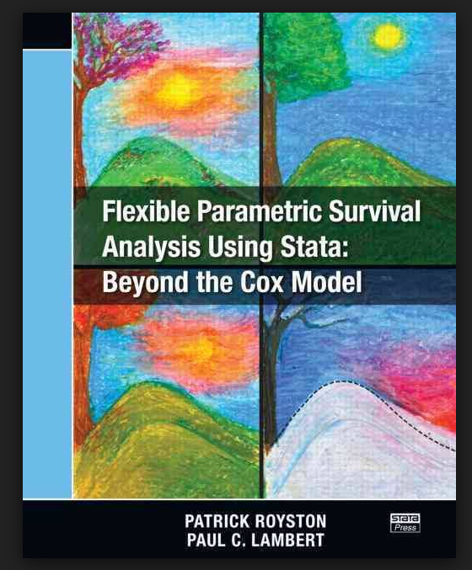
Credits:
Patrick Royston
Paul Lambert
Paul Dickman
Michael Crowther
Royston and Lambert 2011

Slide 6
Standard Survival analysis

Slide 7
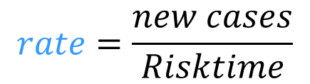
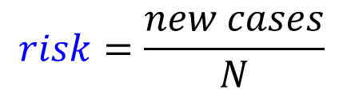
Cohorts
Closed cohort
Open cohort
Count persons, risk
Count person-time, rate
$$risk=\frac{new cases}{N}$$
$$rate=\frac{new cases}{Risktime}$$
Hazard = instantaneous rate, h(t)
Survival = S(t)
Effect measures:
Difference or Ratio measures of h(t) or S(t)
Notes:
Line= follow up
Circle=event (disease)
Red line=exposed

Slide 8
Time to Event (survival) analysis
Timeline, outcome T and d
Hazard Ratio (function)
event
censor
Survival function (data)
Hazard function (model)
hazards
Proportional
20 new cases per 100 py
20% risk now if survived
Notes:
Figures from “The Hazard of HR, survsim”
Hazard=Pr(event|survived) in next time unit

Slide 9


Cox model
$$h\left(t\right)=h_{0}\left(t\right)∙exp⁡(b_{1}x_{1})$$
Proportional hazard model
hazard
baseline
Hazard Ratio
$$HR_{1}=exp⁡(b_{1})$$
(t)
(t)
constant
free
semi-parametric
baseline
HR of females/males
(Cox 1972)

Slide 10
Syntax, Cox
stset
  stset survtime, failure(dead)
Kaplan-Meier plot of survival by treatment
  sts graph, by(trt) risktable
Log rank test of difference in survival
  sts test trt
Cox proportional hazard model with one covariate
  stcox trt
Predicted hazard curves from Cox model
  stcurve, hazard at1(trt=0) at2(trt=1)

Slide 11
Syntax
“5,0 Cox model“
“Standard Survival Analysis”
line 20

Slide 12
Limitations of the Cox model

Slide 13
Reference risk, baseline hazard
Log-risk model
Twice the risk of what?
RR=2
Always report the reference (baseline) risk
Cox model
Twice the rate of what?
HR=2
Always report the baseline hazard, h₀(t)
A lot of information
in the baseline hazard
not visible in the survival curve
Peak at 0.25 years
Still positive hazard
after 6 years
Hazards near 0 may give large HR

Slide 14
Problems with the Cox model
Baseline hazard estimation may be unstable
Handling non-proportional hazards is a bit limited or difficult.
Predict options are somewhat limited
The margins command is limited

Slide 15
Flexible parametric survival models
Royston-Parmar models
Royston and Lambert 2011

Slide 16
Smoothers
Polynomials, fractional polynomial, splines

Slide 17
Smoother example

Slide 18
Smoothers in regressions
Polynomials
  x, x^{2,} x³
Fractional polynomials (2 of 8)
  x⁻², x⁻¹, x^{-0.5} log(x), x^{0.5} x, x², x³
y
x
Splines (restricted cubic splines, rcs)
  cubic
knot
y
c₁
c₂
Splines in Flexible Parametric:
Dose-response
Baseline hazards
Time Dependent effects
x
Polynomials: global
Splines: local
(Govindarajulu, Malloy et al. 2009, Binder, Sauerbrei et al. 2013, Kahan, Rushton et al. 2016)
Notes:
2 of 6 =28 models
2 of 8=

Slide 19

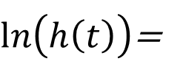

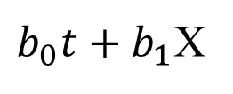


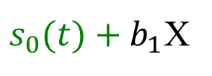
Splines for Baseline, dose-response and TD
t= time
X= exposure (cont.)
s(.)=spline
TD=Time Dependent HR
= non-proportional hazards
Generic models
$\ln\left(h\left(t\right)\right)$=
$b_{0}t+b_{1}$X
Linear baseline, linear X
$s_{0}(t)+b_{1}$X
Flexible baseline
$s_{0}(t)+s_{1}(X)$
Flexible dose response
$s_{0}\left(t\right)+b_{1}X+b_{2}t X$
linear TD (non proportional hazard)
$s_{0}\left(t\right)+b_{1}X+s_{2}\left(t\right) X$
Flexible TD
Flexible Parametric models (Royston-Parmar)
H(t)= cumulative hazard
$$\ln\left(H\left(t\right)\right)=s(\ln{t)+b_{1}X}$$
Proportional hazard
$$\ln\left(H\left(t\right)\right)=s(\ln{t)+b_{1}X+s_{2}(\ln{t) X}}$$
Flexible TD
df
baseline
dftvc
TD
df=degrees of freedom=number of splines
tvc=time varying coefficient

Slide 20
Syntax, stpm3
Stata syntax
  stpm3 variables, scale(lncumhazard) df(2)
Survival time
parametric model
version 3
Log cum. hazard model
2 degrees of freedom
for baseline hazard
=
2 cubic splines
No “dftvc” term: proportional hazard model
Questions:
How many splines to use for the baseline hazard?
How do the “stpm3” estimates compare to the Cox model?
R: flexsurv

Slide 21
Syntax
“5,1 Flexible Parametric Survival“
“PH1 versus PH2”

Slide 22
Summing up so far
Number of splines
  2-6 splines for the baseline hazard
Cox vs. Flexible Parametric
  Same estimates under standard conditions
Baseline hazard
  Important information
  Cox can be unstable in small data sets

Slide 23
Predict

Slide 24
Powerful predict command
Survival
standardized
Hazard
Model
Proportional
hazards model
Predict
RMST
and more!
Survival difference
Hazard ratio
Hazard difference

Slide 25
Predict
Model
stpm3 trt, scale(lncumhazard) df(2) eform
Predict
predict s0 s1, survival ci /// new variables s0 and s1 with CI
at1(trt 0) /// s0
at2(trt 1) /// s1
contrast(difference) /// difference or ratio
contrastvars(sdiff) /// new variable sdiff
timevar(0 6, step(0.1)) /// new time variable tt
frame(f1, replace) // predict into frame f1
Plot
frame f1: twoway …
OBS, all covariates must be specified when using a new timescale

Slide 26
Syntax
“5,1 Flexible Parametric Survival“
“Predict options”

Slide 27
Assumptions of the standard model
Proportional Hazards
Linear dose response
No interactions
Non-informative censoring

Slide 28
Non-proportional hazards
Time Dependent HR

Slide 29
Proportional vs non-proportional
Proportional
Non-Proportional
Non-
Have used splines to model
baseline
(and
dose-response)
baseline
Hazards
Non-
Hazard Ratios
Splines
to model
TD
HR female/male
Time Dependent HR

Slide 30
Smoothers for Baseline, dose-response and TD
t= time
X= exposure (cont.)
s(.)=spline
TD=Time Dependent HR
= non-proportional hazards
Generic models
$\ln\left(h\left(t\right)\right)$=
$b_{0}t+b_{1}$X
Linear baseline, linear X
$s_{0}(t)+b_{1}$X
Flexible baseline
$s_{0}(t)+s_{1}(X)$
Flexible dose response
$s_{0}\left(t\right)+b_{1}X+b_{2}t X$
linear TD (non proportional hazard)
$s_{0}\left(t\right)+b_{1}X+s_{2}\left(t\right) X$
Flexible TD
Flexible Parametric models (Royston-Parmar)
H(t)= cumulative hazard
$$\ln\left(H\left(t\right)\right)=s(\ln{t)+b_{1}X}$$
Proportional hazard
$$\ln\left(H\left(t\right)\right)=s(\ln{t)+b_{1}X+s_{2}(\ln{t) X}}$$
Flexible TD
df
baseline
dftvc
TD
df=degrees of freedom=number of splines
tvc=time varying coefficient

Slide 31
Non-Proportional Cox vs Flexible par.
Non-Proportional Hazards = Time Dependent HR
= Time Varying Coefficients (tvc)
Cox model options
time dependent effect
tvc(var) texp(_t)
tvc(var) texp(_t>5)
tvc(var) texp(ln(_t))
stsplit
Syntax:
5.0 Cox model
Flexible parametric options
tvc(var) dftvc(2)
two splines

Slide 32
Model commands
Proportional hazards
stpm3 sex, scale(lncumhazard) df(4) eform
Non-proportional hazards = Time Dependent HR
stpm3 sex, scale(lncumhazard) df(4) eform tvc(sex) dftvc(2)
Time varying coefficient
of sex, with 2 splines
Testing for non-proportional hazards
Standard method
Easier method, Flexible Parametric
Fit at PH model
Plot Schoenfeld residuals
Add “tvc” or stplit as needed
Add “tvc” terms for the exposure
(test PH vs TD with LR-test)
Predict and plot HR
Syntax: 5.0 Cox model
Test Proportional Hazards assumption
“tvc” for confounders?

Slide 33
Syntax
“5,1 Flexible Parametric Survival “
“PH versus TD models using female as exposure”

Slide 34
Summary so far
Effect of sex on melanoma survival
  PH model ⇒ constant HR
  Non-PH model ⇒ time dependent HR (TD)
Next
  TD hazard ratios for age
  Are the sex estimates the same (PH vs TD for age)?
  Handle huge HR caused by hazards close to zero
    Plot HR restricted range
    Plot HD (hazard differences)

Slide 35
Syntax
“5,1 Flexible Parametric Survival “
“PH versus TD models using age groups”

Slide 36
Summary so far
TD hazard ratios for age
Exposure: sex estimates the same (PH vs TD for age)
  TD for the confounder age was not needed
Exposure: age
  Plot HR, Table of HR
Huge HR caused by hazards close to zero
  Plot HR from 1-10 years (avoid time 0)

Slide 37
Time dependent HR
Huge HR
Use HD instead
or plot from 1-10
Proportional HR

Slide 38
Dose response modeling
Replace exposure with spline object
  Age as exposure
stpm3 @ns(age, df(3)) i.hormon, scale(lncumhazard) df(5)
Natural spline in age
spline for baseline hazard
Spline objects
  Easy to use
  Easy to predict from the model!
Go to syntax

Slide 39
Problems with the HR. Frailty Selection Bias
RandomizedControlledTrial example
  High and variable risk of dying (heterogeneity, frailty)
  Strong treatment effect (HR=0.5 for all subjects)
    Start: balanced, comparable groups
    Over time treated: frail subjects will remain
    Over time untreated: frail subjects will die out
    HR may go from 0.5 (true) to 1.5 (misleading) over time
Use instead of the HR:
  Restricted Mean Survival Time
  Standardized Survival Curves
Use HR with caution if large and varying risk of event
(Hernan 2010; Stensrud et al. 2019; Stensrud and Hernan 2020)

Slide 40
Alterative measures to the Hazard Ratio
Standardized Survival Curves, Restricted Mean Survival Time

Slide 41
Standardized Survival Curves
Model
stpm3 trt age sex, scale(lncumhazard) df(2) eform
Standardized Predictions
range t3 0 6 101 // 101 values from 0 to 6
standsurv, survival at1(trt 0) at2(trt 1) atvars(S0 S1) ci timevar(t3)
untreated and treated
Standardized to all variables in the model
not specified in “standsurv” command:
Age and sex
Go to syntax

Slide 42
Restricted Mean Survival Time
RMST = area under the survival curve
Difference in RMST = area between the survival curves
Restrict to the observation time
Restricted Mean Survival Time Difference at max follow up
Natural measure of effect, alternative to the Hazard Ratio
Not affected by frailty bias of the Hazard Ratio
Just one number also for Time Dependent Hazard Ratios
Affected by competing risk
Go to syntax

Slide 43
Summing up
Cox model
  Proportional Hazards ⇒ constant HR
  Limited options for non-proportional hazards
Flexible Parametric Survival model
  Proportional Hazards ⇒ constant HR
  Flexible non-proportional hazards (splines)
    Hazards, Hazard Ratios, Hazard Differences, Survival, Survival Differences
Alternatives to the Hazard Ratio
  Standardized Survival Curves
  Restricted Mean Survival Time difference
    One number (with CI) also for time dependent HR

Slide 44
Other features of Flexible Parametric models
Relative survival. Competing risk
Joint modelling of longitudinal and survival data
Nested Case-Control and Case-Cohort (also Cox)
Multistate models (event history analysis)
Simulation of survival data
Merlin, a unified framework for data-analysis
(Lambert et al. 2010)(Hinchliffe and Lambert 2013)(Crowther et al. 2013)(Borgan and Samuelsen 2013) (Crowther and Lambert 2017)(Crowther and Lambert 2013)(Crowther 2018)

Slide 45
References
Binder H, Sauerbrei W, Royston P. 2013. Comparison between splines and fractional polynomials for multivariable model building with continuous covariates: A simulation study with continuous response. Stat Med 32:2262-2277.
Borgan O, Samuelsen SO. 2013. Nested case-control and case-cohort studies. In: Handbook of survival analysis, (Klein JP, van Houwelingen HC, Ibrahim JG, Scheike TH, eds).
Cox D. 1972. Regression models and life tables. J Roy Statist Soc B 34:187-220.
Crowther MJ, Abrams KR, Lambert PC. 2013. Joint modeling of longitudinal and survival data. Stata Journal 13:165-184.
Crowther MJ, Lambert PC. 2013. Simulating biologically plausible complex survival data. Statistics in Medicine 32:4118-4134.
Crowther MJ, Lambert PC. 2017. Parametric multistate survival models: Flexible modelling allowing transition-specific distributions with application to estimating clinically useful measures of effect differences. Stat Med 36:4719-4742.
Crowther MJ. 2018. Merlin - a unified modelling framework for data analysis and methods development in stata.
Daniel R, Zhang J, Farewell D. 2020. Making apples from oranges: Comparing noncollapsible effect estimators and their standard errors after adjustment for different covariate sets. Biom J.
Govindarajulu US, Malloy EJ, Ganguli B, Spiegelman D, Eisen EA. 2009. The comparison of alternative smoothing methods for fitting non-linear exposure-response relationships with cox models in a simulation study. Int J Biostat 5.
Hernan MA. 2010. The hazards of hazard ratios. Epidemiology 21:13-15.
Hinchliffe SR, Lambert PC. 2013. Extending the flexible parametric survival model for competing risks. Stata Journal 13:344-355.
Kahan BC, Rushton H, Morris TP, Daniel RM. 2016. A comparison of methods to adjust for continuous covariates in the analysis of randomised trials. BMC medical research methodology 16.
Lambert P, Royston P. 2016. Flexible parametric alternatives to the cox model. In: Course, Slides.
Lambert PC, Royston P. 2009. Further development of flexible parametric models for survival analysis. Stata Journal 9:265-290.
Lambert PC, Dickman PW, Nelson CP, Royston P. 2010. Estimating the crude probability of death due to cancer and other causes using relative survival models. Stat Med 29:885-895.
Royston P, Lambert P. 2011. Flexible parametric survival analysis using stata: Beyond the cox model. 4905 Lakeway Drive, Collage Station, Texas:Stata Press.
Stensrud MJ, Aalen JM, Aalen OO, Valberg M. 2019. Limitations of hazard ratios in clinical trials. Eur Heart J 40:1378-1383.
Stensrud MJ, Hernan MA. 2020. Why test for proportional hazards? JAMA.

Slide 46
Course Files

Slide 47
Software
* ------------------ From Statistical Software Components ----------------------
* Flexible Parametric Survival
ssc install stpm2, replace
* Restricted Cubic Splines
ssc install rcsgen, replace
ssc install strcs, replace
* Competing risk
ssc install stcompet, replace
ssc install stcompadj, replace
ssc install stpm2cm, replace
ssc install stpm2cif, replace
ssc install stpepemori, replace
* Explained variance
ssc install str2d, replace
* Imputation
ssc install stsurvimpute, replace
* Symmetric nearest neighbor smoothing
ssc install running, replace
* ------------------ Not from Statistical Software Components ------------------
* Relative survival, manual install
search strs

Slide 48
Syntax and data files
* Download Paul Dickman course files
mkdir c:\survival
cd c:\survival
net install http://www.pauldickman.com/survival/course_files, all replace
* Download Royston-Lambert book material
net from http://www.stata-press.com/data/fpsaus/
net get fpsaus-dta
net get fpsaus-do1
net get fpsaus-do2
* Syntax files for this course
Opus>Metodelunsj>Delte dokumenter>Flexible Parametric Survival Course:
0 Flexible Parametric Survival Course, Downloads.do
1 Flexible Parametric Survival Course, Basic.do
2 Flexible Parametric Survival Course, TD.do
3 Flexible Parametric Survival Course, Spesial.do

Slide 49
Extra slides

Slide 50


Generalized Weibull model
Often used parametric model: Weibull
Log cumulative hazard is linear in log t:
$$\ln{H\left(t\right)}=k\ln{t−k ln{λ}}$$
Generalize to (any) smooth baseline hazard:
$$\ln{H\left(t\right)}=s(\ln{t)−k ln{λ}}$$
s=spline
Stable estimates on the log cumulative hazard scale.
Splines generalize to (almost) any baseline hazard shape.
Proportional hazard model

Slide 51
Purpose of regression
Estimation
  Estimate association between exposure and outcome adjusted for other covariates
  Estimate the effect of smoking on lung cancer
Prediction
  Use an estimated model to predict the outcome given covariates in a new dataset
  Predict air pollution by distance from roads
DAGs, bias, precision
Predictive power, model fit, R²
Notes:
Counfounding matter in the first
Fit of the models matters in the last

Slide 52




Baseline, dose-response and TD
t= time
E= exposure (cont.)
s(.)=spline
tvc=time varying coeff
Generic model
$\ln\left(h\left(t\right)\right)$=
$$b_{0}t +{ b}_{1}E +{ b}_{2}t E$$
$$s_{0}\left(t\right)$$
$$+ s_{1}\left(E\right)$$
$+{ s}_{2}\left(t\right) s_{1}(E)$
baseline
dose
response
Time
Dependent
Flexible parametric model
  stpm2
  agercs?,
  df(3)
  dftvc(2) tvc(agercs?)

Slide 53
Cox versus Royston-Parmar-PH
Both are proportional hazards models
Almost identical effect estimates
But:

Slide 54
Ex: unstable hazards from Cox model
FP=
Flexible
Parametric
Cox baseline
and treated
FP baseline
FP treated
Conclusion: unstable hazards from the Cox model (with artifacts)

Slide 55
Relative survival
Patient register
Population
Individual data
Tabular data
What is the survival of patients relative to the population?
SMR
Relative Survival

Slide 56
Model Assumptions
Baseline hazard, Proportional hazards, Time dependent hazards

Slide 57
Proportional vs non-proportional
Proportional
Non-Proportional
Non-
baseline
Hazards
how to model
baseline,
dose-response,
and TD
Non-
Hazard Ratios
time dependent, TD

Slide 58
Survival models
Cox
Parametric
Flexible
Baseline hazard:
free
time
time
Estimate
baseline hazard:
may be
unstable
easy, stable
easy, stable

Slide 59
Cohorts
Open cohort
Count person-time, rate
Statistics
Open cohort, new time scale
Survival data
Time to event data
Censored data
MF 9510 Logistic, Survival and Cox
Notes:
Line= follow up
Circle=event (disease)
Red line=exposed

Slide 60
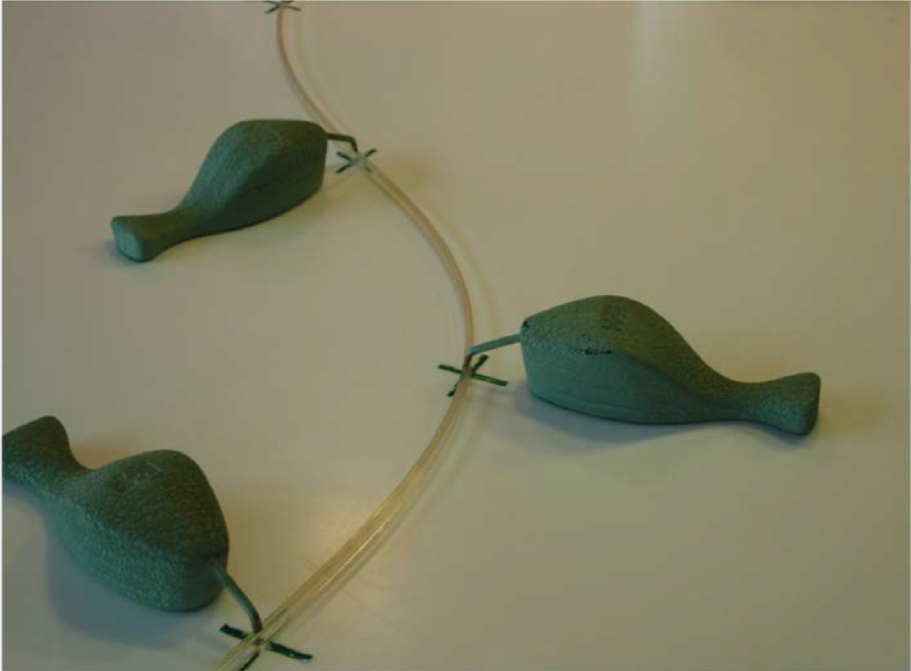
A physical “spline”

Slide 61
Flexible Parametric models
$$stpm2: ln\left(H\left(t\right)\right)=s(\ln{t)+X∙β}$$
$$strcs: ln\left(h\left(t\right)\right)=s(\ln{t)+X∙β}$$

Slide 62
Timescale
Possible timescales:
Time since diagnosis
Age
Calendar time
Chose timescale:
the most important
or most non-linear
as analysis time
Stata commands, stset:
Risk time (in red) from diagnosis
to death, lost to follow-up or end of study
origin start of risk time
enter enter study
exit exit study
failure event (death) or not

