Slide 1
Sparse Data Bias 1h
Hein Stigum
Arbeidsrom “Metodelunsj”
https://folkehelse.sharepoint.com/sites/1094
Notes:
Needs 3 extra files from: C:\Users\hest\Documents\Methods\Sparse Data Bias
Excel: Sparse Data Bias. xlsx
Stata: Sparse Data Bias, program.do Sparse Data Bias, results.do

Slide 2
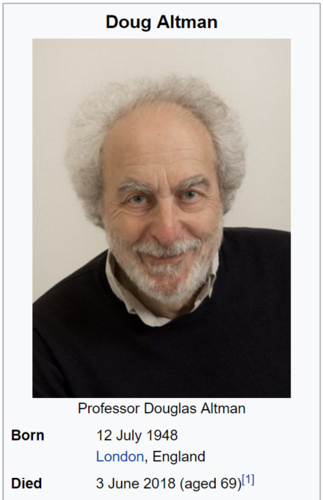
High impact paper
Greenland S, Mansournia MA, Altman DG.
2016.
Sparse data bias: A problem hiding in plain sight.
BMJ-Brit Med J 353.

Slide 3
Agenda
Sparse Data Bias
Explained
2 by 2 table
Adjusted regression
Diagnostic
Penalized regression
Remedy
Penalized regression
(Orsini; and Greenland 2015)(Greenland, Mansournia et al. 2016)

Slide 4
Sparse Data Bias in 2 by 2 table
go to Excel

Slide 5
Sparse Data Bias in regression

Slide 6
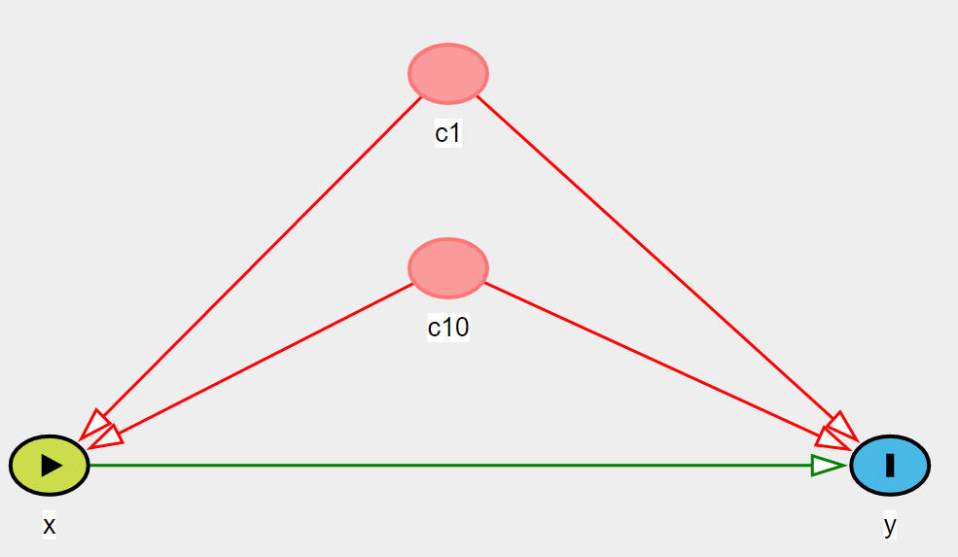
Simulated data: DAG
Prev=50%
OR=2
OR=2
OR=2
OR=2
Prev=10%
OR=2
Prev=5%
10 medium strong confounders ⇒ strong (pos) confounding

Slide 7
Sparse Data Bias in regression with many covariates
go to Stata
Explained example
Single simulations

Slide 8
Radiation and childhood leukemia
Exposure
Radiation from nuclear reprocessing (0/1)
Outcome
Childhood leukemia (0/1)
N=24
Estimated OR=57
Discard the study?
Agree on a range:
OR is unlikely to be outside (1/40, 40)
(Greenland, Mansournia et al. 2016)

Slide 9
Penalized regression
Many variants:
Lasso
Penalized on the sum of the abs(β)
for variable selection, interaction selection
Penalization or approximate Bayesian
Penalize if a given β is outside a given range
external (or prior) information to improve accuracy over repeated studies.
Can be implemented by data augmentation, translating prior distributions into prior-data records. Standard software.
Stata: findit penlogit
(Tibshirani 1996)(Greenland, Mansournia et al. 2016)
Notes:
(Hastie and Tibshirani 1990)

Slide 10
Penalized regression, approximate Bayes
Descide on a plausible range for OR
Run penlogit, …
go to Stata
penalized regression

Slide 11
How bad can it get?
N=500, True OR=2.0
Example
Logistic: OR=1.2
Penalized (1,5): OR=1.8
Is this a rare, unlikely result?
Simulate the N=500 population many times
Make a distribution plot of the estimates ORs

Slide 12
1.2
1.8

Slide 13
Rule of thumb:
1000*5% =50cases
Can handle 5 covariates

Slide 15
Use Profile Likelihood CIs
penlogit Y X C1-C10, nprior(X ln(2.4) 0.2) or ppl(X)
Allows non-symmetrical CIs (on the log-OR scale)
N=500, True OR=2.0

Slide 16
Recommendations

Slide 17
Avoid Sparse Data Bias, Design
$$se\left(\log\left(OR\right)\right)=\sqrt{\frac{1}{a}+\frac{1}{b}+\frac{1}{c}+\frac{1}{d}}$$
Do sample size calculations
Match on some strong confounders (sex and age)

Slide 18
Handle Sparse Data Bias, Analysis
If number of covariates>10% of cases
or
2*2 table has low cell number
or
Crude and adjusted ORs are very different
⇒
try penalized regression
If adjusted and penalized are different
sign of sparse data bias

Slide 19
Extra
Penalized regression may also work for
Full separation
Collinear variables

Slide 20
Summing up
Sparse Data Bias
occurs in 2*2 tables with low cell counts
or regression models with many covariates per case
result of “rounding off” and randomness
Rules of thumb: number of covariates≤
10% of the cases (logistic)
10% of N (linear regression)
Penalized regression
diagnostic tool
solution

Slide 21
References
Discacciati; A, Orsini; N, Greenland S. 2015. Approximate bayesian logistic regression via penalized likelihood by data augmentation. The Stata Journal 15:712–736.
Greenland S, Mansournia MA, Altman DG. 2016. Sparse data bias: A problem hiding in plain sight. Bmj-Brit Med J 353.
Tibshirani R. 1996. Regression shrinkage and selection via the lasso. J R Statist Soc 58:267-288.

