Slide 1
Analyzing repeated measurements
(mixed models, generalized estimating equation, paired t-test …)
Analyse av
repeterte målinger
(mixed models, generalized estimating equation, paired t-test …)
Harald Weedon-Fekjær
Oslo Center for Biostatistics and Epidemiology
Masterclass for Sørlandet Sykehus, 2021-04-16 11:30-12:30
Notes:
Master class (nett/Sørlandet sykehus) Fredag d. 16. april kl. 11:30-12:30.
Med utgangspunkt i en studie fra en av forskerne ved Sørlandet Sykehus, John Kåre Vederhus er tittel for denne master class:
«Analyse av repeterte målinger i helseforskning, med en anvendelse på data fra
en pårørendestudie ved avdeling for rus- og avhengighetsbehandling, Sørlandet Sykehus»
Sted: Skype for Business: https://join.sykehuspartner.no/sshf/meet/emile.van.gelderen/6CZHHTTQ
John-Kåre Vederhus <john-kare.vederhus@sshf.no> 91610859
Admin: Gudrun Elin Rohde <gudrun.rohde@sshf.no> 99164094
---
Beskrivelse av master class: Hensikten med den personlige veiledning er gjennom en samtale med statistikeren at nå frem til løsningen på et (konkret) problem. Mange av de problemer statistikeren kommer bort i, i sin veiledning, er av mere generell karakter og samtalen kan derfor ofte ha interesse for og berikes av flere deltakere. En master class er også en samtale mellom en forsker og en statistiker med utgangspunkt i et konkret problem, bare med den forskjell at andre forskere er med som tilskuere. Samtalen etterfølges av en plenum diskusjon, hvor også de øvrige forskere kan stille spørsmål eller kommentere.
---
1) Vi presentere oss og jeg sier noen ord om veilednignstjenesten
(først han)
Min kunnskap statistikk – dekker hele feltet - må forklares medisinen,
sentralt UiO-OuS HSØ på høyt nivå; phd gjerne proff komp.,
veileder i metode og programvare,
men også forskingstankegang (erfaring opp forsking)
2) Problemstilling og data («domain expert»)
3) Jeg presenetere «mixed models»
4) Viser kort «mixed models» i SPSS på klasisk eksempel datasett
(eller Stata/R)
5) Diskusjon.

Slide 2



Oslo Centre for Biostatistics and Epidemiology [OCBE] http://www.med.uio.no/imb/english/research/centres/ocbe/
Universitet i Oslo,
Det medisinske fakultet
Arnoldo Frigessi,
leder OCBE
Undervisning i biostatistikk
Veiledning i biostatistikk
Biostatistikk forsking
Notes:
Oslo Centre for Biostatistics and Epidemiology (OCBE) is a joint center integrating the activities of the
Department of Biostatistics, UiO and the Section of Biostatistics, Epidemiology and Health Economics, OUS

Slide 3

Planla å reise til Sørlandet Sykehus
Hadde gjort avtaler om veiledning
Planlagt overnattingen
Planlagt middagen
…
…
…
Og så kom det en pandemi ☹
… men BioNTech sin løsning er på vei

Slide 4
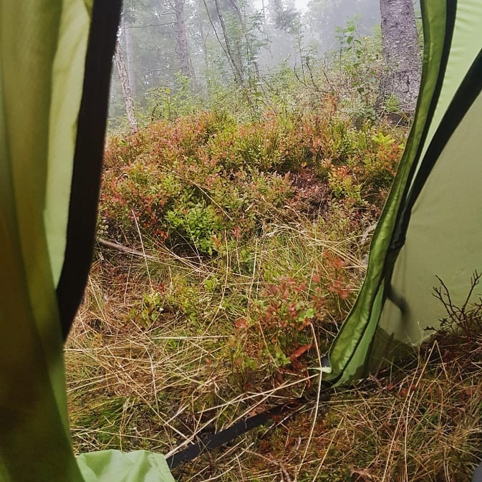


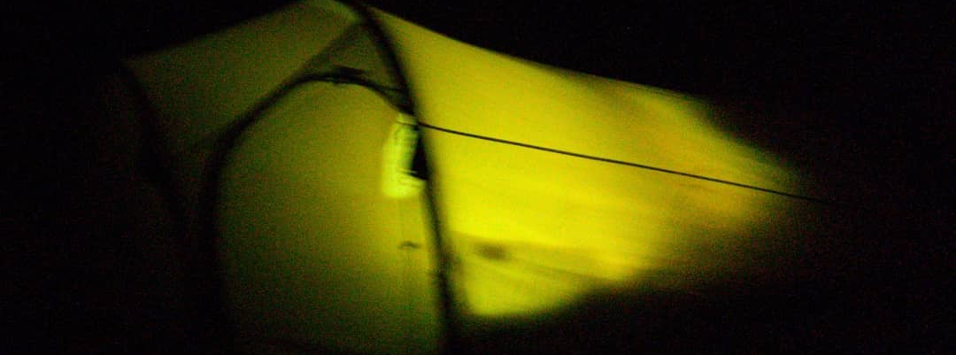
Jeg har ikke gitt opp, jeg kommer igjen;
Middagen er ikke spist og skogen står der stadig 😉

Slide 5
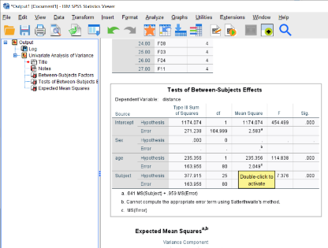
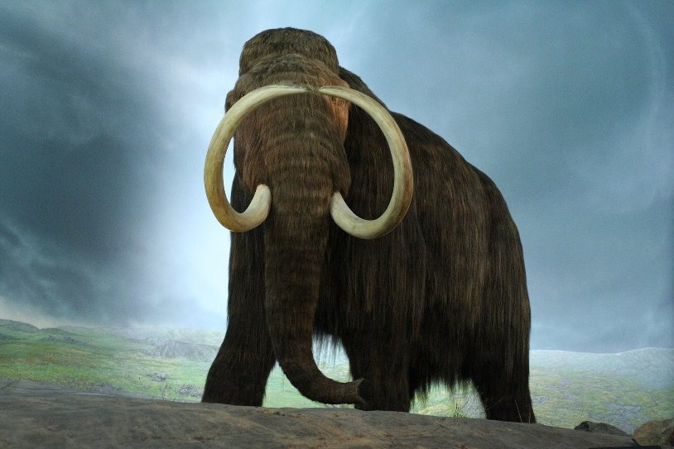
How do we analyze repeated measurements?
ANOVA ? (analysis of variance)
Old classical approach
Easy to calculate by hand
… but:
  Gives p-values, not estimated
  (clinical relevant) properties
  with confidence interval
  No unbalanced missing data
  Not very flexible
An endangered method for repeated measurements?

Slide 6

How do we analyze repeated measurements?
Mixed models regression
The modern flexible approach
to repeated measurements
Works in Stata, R and SPSS
An extension of ordinary regression analysis
Estimates effects with
confidence intervals

Slide 7
Random effects (Modelling individual effects)
Classic basic statistical model: (linear regression etc.)
Y = “covariate effects” + “random noise”
A mixed effects model with random effects:
Y = “covariate effects” + “individual variation” + “random noise”
=> We take into account individual variation by random effects
(random effects might be used for all sorts of cluster data)
Notes:
Assumptions;
The individual women level comes from a
normal distribution of potential individual effects

Slide 8
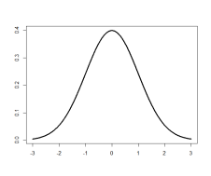


Random effects (Modelling individual effects)
Classic basic statistical model: (linear regression etc.)
A mixed effects model with random effects:
Assumptions;
The individual level comes from
a normal distribution,
(like the normal distributed random noise)
$$Y_{i} = α+ β ∗X+ ε_{i}$$
$$Y_{i,j} = α + β ∗X+ u_{j}. + ε_{i,j}$$
Notes:
Assumptions;
The individual women level comes from a
normal distribution of potential individual effects

Slide 9
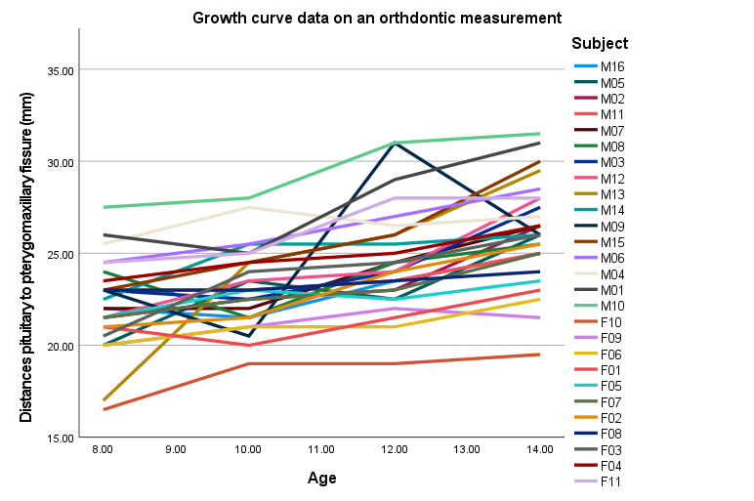
Random (individual) effects
M10 have general long
distance between
pituitary and
pterygomaxillary
fissure
F04 have general short
distance between
pituitary and
pterygomaxillary
fissure

Slide 10
Mixed effects models
  Mixed effects models might be complex with:
    Many different levels/clusters
    Advanced covariance structures
    Non-linear expected (mean) values
  Individual with more observations influence the estimates more, but new individuals is usually more important than one more repeated observation
Mixed effects models could be used in both:
  linear regression
  logistic regression
  poison regression
  Survival analysis (="frailty models”)

Slide 11
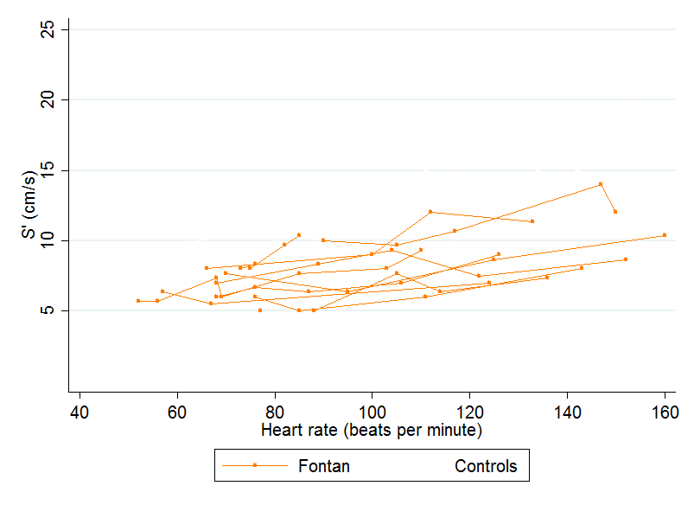
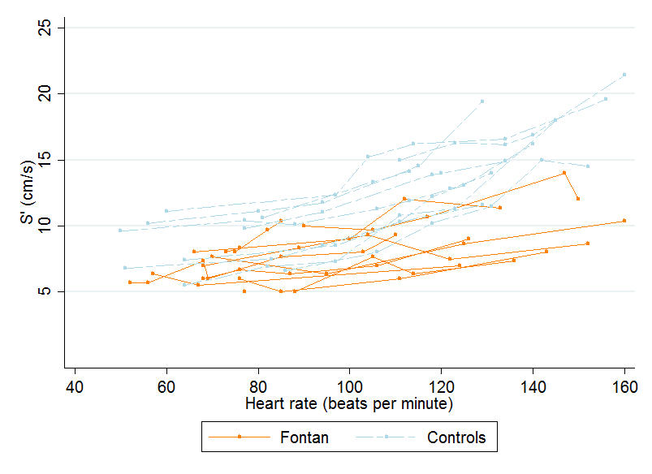
Cardiac performance during exercise with Fontan circulation - data
Notes:
Long term follow-up of heart operated children
Proktect: Moller-hwf-Veil030 (Thomas, RH, OuS / SiV)
“Cardiac performance during exercise and aerobic capacity in adult patients with Fontan circulation”

Slide 12
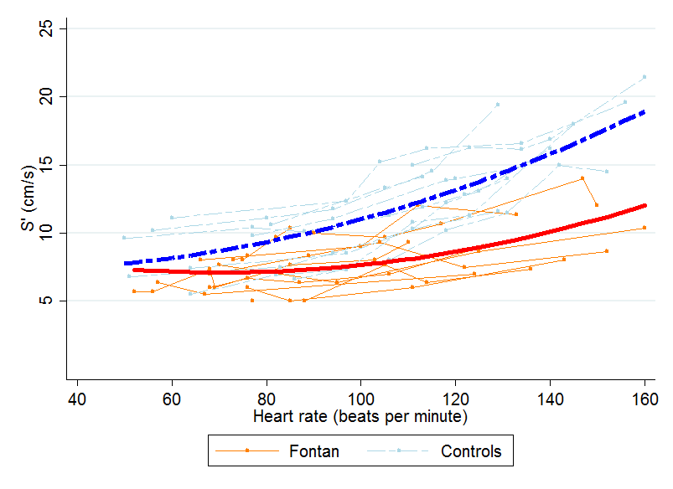
Cardiac performance during exercise with Fontan circulation - data
Notes:
Long term follow-up of heart operated children
Proktect: Moller-hwf-Veil030 (Thomas, RH, OuS / SiV)

Slide 13
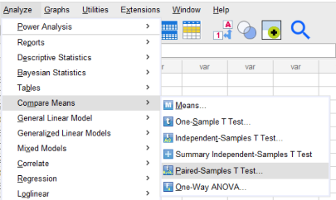
Do we always need mixed effects models?
When we compare first and last observation;
Why not just work with difference last-first?
(pared samples t-test & confidence intervals)
Is one option to first take the mean of each group?
(typically only for balanced designs without missing)

Slide 14
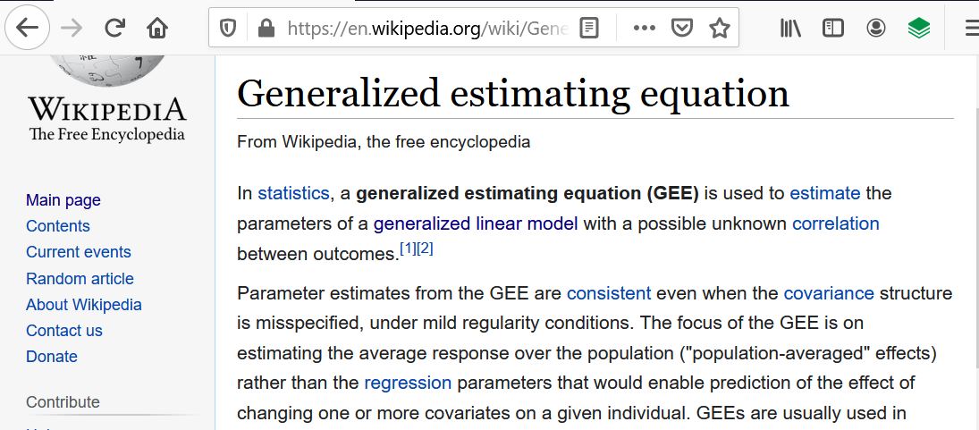
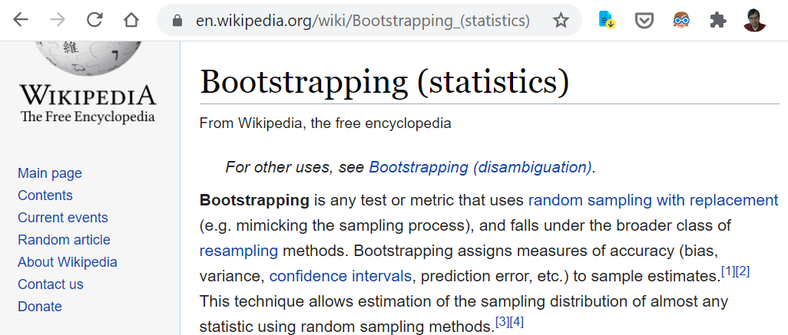
Non normal (continues variable) distributed data?
Generalized estimating equations (gee)
is an option for non normal distributed data with decent number of clusters/individuals
Bootstrap is a good robust method, but be careful with the standard SPSS implementation (not recommended!)

Slide 15
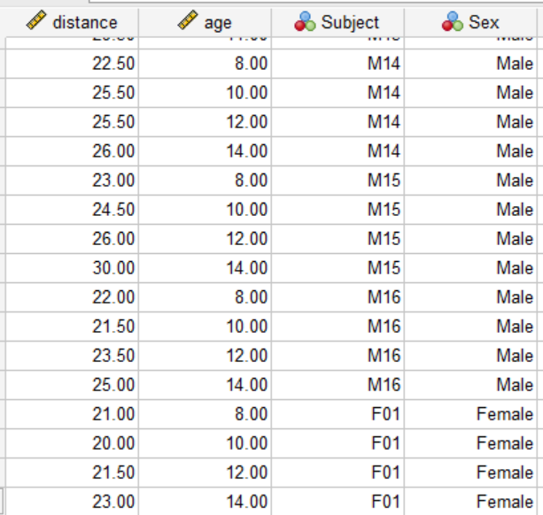
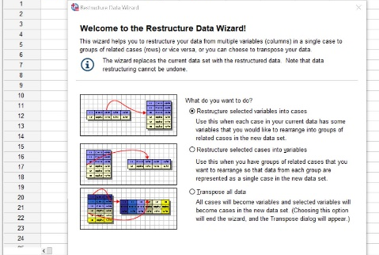
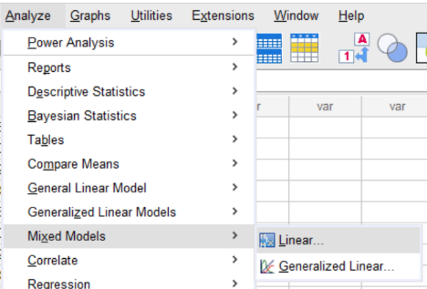
Data format and short demo
Mixed effects models take
data on “long format”;
One observation per line
with shared id.
Stata/SPSS/R have routines to
convert from “wide” to “long” format
Stata/SPSS/R all have comprehensive
mixed models estimation routines

Slide 16
Analyzing repeated measurements
Summary:
(drop ANOVA analysis)
First look for simplifications (marginal means etc.)
Use mixed effects models with random components
for complex data taking into account
individual variations and covariences
Mixed effects models is just an extension of
ordinary generalized linear models with individual variation (but can become very complex)

Slide 17

Spørsmål?
Steilene, Nesodden, Norway, 2013-06-14
Harald Weedon-Fekjær (statistician, PhD), OCBE, Oslo University Hospital
E-mail: <harald.weedon-fekjar@medisin.uio.no>

Slide 18
Referanser:
Mixed models:
https://en.wikipedia.org/wiki/Mixed_model
https://stats.idre.ucla.edu/other/mult-pkg/introduction-to-linear-mixed-models/
SPSS:
https://www.ibm.com/analytics/spss-statistics-software
https://stats.idre.ucla.edu/spss/seminars/spss-mixed-command/
Stata:
https://www.stata.com/
https://www.stata.com/features/multilevel-mixed-effects-models/
R:
https://www.r-project.org/
https://cran.r-project.org/web/packages/lme4/vignettes/lmer.pdf

