Slide 1
Senter for bærekraftig helseutdanning (SHE)
Notes:
My name is EE, I’m the vice-dean for postgraduate studies at MFO and chair of the SHE Management Board. I’m here with a group representing different functions in the SHE Management: The pro-dean for the medical study program, Elin Olaug Rosvold, the Leader of SHE, Kristin Heggen, and the student member of the SHE management, Tiril Reed.
Thank you for your inspiring and positive assessment of our centre plan! In this presentation we will first present the overall idea and concept of the centre, and second, we will address the questions you raised in your comments.

Slide 2
FNs bærekraftsmål og SHE
Vår tilnærming
Systemtilærming: Økologisk, sosial og økonomisk utvikling må sees i sammenheng
Fremtidsrettede: Beslutninger som fattes i dag må ivareta fremtidige generasjoners behov
Universell: Planen skal være retningsgivende for alle, “ingen skal utelates”
Notes:
EE
With this centre we will contribute to the implementation of the SDGs in higher education.
In our understanding there are three core ideas underpinning the SDGs and Education for sustainable development….

Slide 3
SHE visjon
Globalt orienterte helsearbeidere
tar bærekraftige beslutninger
som ivaretar fremtidens behov.
Notes:
EE
Here is our overall vision

Slide 4
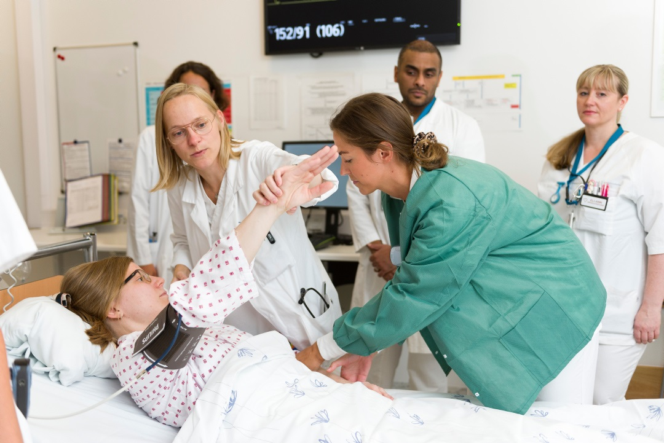
Hvorfor nå?
Fremtidens helsearbeidere må tenke og handle bærekraftig
Multimorbiditet
Eldrebølge
Migrasjon
Klimaendringer
Resistente bakterier
Fremtidens helsebehov er større enn helsetjenesten kan dekke.
Notes:
EE: SDG-education in health studies – why now?
Future health care is confronted with serious sustainability issues, e.g.

Slide 5
Hvorfor nå? Et eksempel
Antibiotikaresistens (AMR)
Notes:
EE: SDG-education in health studies – why now?
The case of antibiotic resistence demonstrates, that we must think and act beyond the needs of the individual patient. A system approach involving at least 6 of the ASGs is needed

Slide 6
SHE
Studentene må:
Reflektere over sin rolle og sitt ansvar bade på individuelt nivå og systemnivå
Være i stand til å gjøre kristiske vurderinger av behov og ulike intervensjoner
Kunne forutse langsiktige konsekvenser av kliniske beslutninger
Notes:
EE: Educating for Sustainable evidence-based decision making
This challenges how we teach decision making to future health workers. Simple knowledge acquisition is not sufficient.

Slide 7
SHE
Bærekraftsmål
Vi utdanner for bærekraftige
evidensbaserte
beslutninger
Forsknings-basert
Individuelle ønsker og behov
Bærekraftige
Evidensbaserte
beslutninger
Eksperter
Notes:
EE:
We must rethink the current model for evidence-based decision making that we teach our students…
To this model there must be added a FOURTH component: GLOBAL and FUTURE consequences of present decisions!
It is only by considering these consequences that evidence-based decisions can be SUSTAINABLE
THE OVERALL AIM OF SHE IS TO IMPLEMENT SUSTAINABLE EVIDENCE-BASED DECISIONS IN HEALTH CARE EDUCATION

Slide 8
Hvorfor oss?
9 studieprogram
Profesjonsstudiet i medisin
Master i klinisk ernæring
Master i avansert gereatrisk sykepleie
Master i Interdisiplinær helseforskning
Master i helseadministrasjon
European Master in Health Economics and Management
Master in Health Economics, Policy and Management
Master in Community Health
Bachelor i helseledelse og helseøkonomi
Notes:
EOR overtar
SDG-education in health studies – why us?
Why us:
In the application we have highlighted past accomplishment related to several of our educational programs. We have nationally been recognized for our excellence in teaching. We are proud of the team at UiO and their desire to offer innovative, state of the art and comprehensive education. Their ability to reflect and adapt to new challenges in education are our foundation, and what gives us confidence to assure that we will be able to successfully develop, implement and complete the activities as outlined in the grant proposal. Furthermore, albeit not systematically several of those competencies and capabilities required for education on the SDGs are already integrated in several of the educational programs. In addition, Research and development is strongly emphasized and we are proud of the research output from our students.

Slide 9
Ledende i digitalisering og e-læring
Høy kompetanse i e-læring
Medvirkning fra lærere og studenter
MOOCs
Studio-fasiliteter
Ultralyd
Studentlærere
Simulering
Digital eksamen
Nasjonal eksamen
Notes:
EOR
The faculty of medicine has high competence on e-learning. Both students and teachers are involved in the production of e-learning courses and MOOCs and we also have studio facilities for this. We have implemented technologies such as ultra sound teaching from year one and we use student as teachers in ultra sound classes and simulation. We have transformed almost all our exams into digital exams and we are also in the lead of developing a national exam in the medical curriculum.

Slide 10
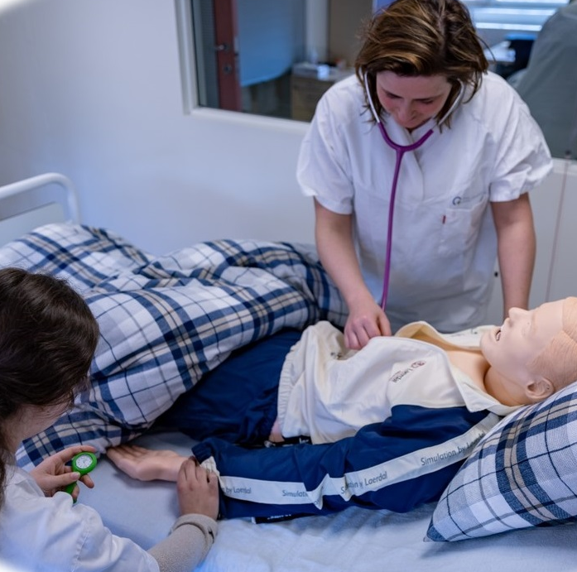
Tverfaglighet og praksisstudier
SamPraks
IPE med 6 profesjonsstudier ved UiO
Fellesundervisning for medisin, odontologi og ernæring
Simulering i primærhelsetjenesten
Foto: SamPraks
Foto: Yngve Vogt, Apollon
Pasienttilpasset medisin
Pasientlærere
Simulering
Foto: L. Kongsvik, Tdnlf
Apollon 1/2017
Notes:
EOR
We are in the lead of interprofessional training at the university of oslo where senior students from 6 professional programs are training IPE in nursing homes. We also have common subjects in medicine, dentistry and clinical nutrition during the first 2 years. We emphasize practice training and simulation, especially in primary care. Patient centered medicine is the focus in our studies and we use patients as educators. In this picture you see the simulation of a patient care team where a former drug abuser is playing the role as himself while the medical student is playing the role as the family doctor.

Slide 11
UNESCOs rammeverk for bærekraftig utdanning
Selvbevisst-het
System-tenkning
Kritisk tenkning
Fremtids-orientering
UNESCO’s nøkkel-kompetanser for bærekraft
Samarbeids-kompetanse
Normativ kompetanse
Integrert problemløsning
Strategisk tenkning
Notes:
EOR
UNESCO’s Key components for sustainability will be our framework. We have in the application emphasized the various existing education components that are in accordance with SDG,s learning strategies.

Slide 12
1. Systemtenkning
Studenter skal kunne:
Utvalgte metoder
Analysere bærekraftproblemstillinger på tvers av de ulike bærekraftmålene
Identifisere mulige intervensjoner og endringsagenter
Diskutere implementeringsstrategier
Beskrive og diskutere hvordan profesjonelle og ulike interessenter kan bidra til å løse bærekraftutfordringer
Kvalitativ og kvantitativ systemanalyse
Nettverksanalyse
Analysere makt, politikk og autoritet I implementeringsprosesser

Slide 13
2. Fremtidsorientering
Studenter skal kunne:
Utvalgte metoder:
Ta beslutninger som ivaretar fremtidige og globale hensyn
Forutse hvordan bærekraftutfordringer vil utvikle seg over tid
Vurdere evidensstøttede alternativer for fremtiden
Motivere til endring
Konstruere og diskutere framtidsscenarioer
Team-basert læring
Kritisk tenkning

Slide 14
3. Normativ kompetanse
Graduates who are “competent in values thinking are able to specify, compare, apply, reconcile and negotiate sustainability values, principles, goals and targets, informed by concepts of justice, fairness, responsibility etc.”
Wiek et al.2016
Utvalgte metoder:
Risikoanalyse
Konfliktorienterte metoder
Case-metoder
Notes:
Could add in various processes, including visioning, assessment and evaluation
Students are able to generate and interpreteresults
Risk analysis, visioning methods
Concensus conferences
Dilemma

Slide 15
Mål og milepæler
Mål etter 2 ½ år
SHE-utvikling med studentene
5-årsmål
Nye ferdigheter, verktøy og undervisningsopplegg er igangsatt
10-årsmål
SHE er et internasjonalt ledende knutepunkt for forskningsbasert ESD
Pågående kommunikasjons-aktiviteter
Modellen er overført til flere HEIs
Notes:
2,5 year: SHE development of skills sets, digital tools and courses has started together with students
5 year: Skills, digital tools and and courses are operational and implemented into MFO programs. New MA developed and operational. Communication and Dissemination activities are operationalized.
10 year: SHE is an International leading hub for research-based ESD. A MOF culture for students as co-teachers and co-researchers in ESD. ESD is cross cutting at MFO and the ESD model transferred to other HEIs.

Slide 16
Implementering av SHE-aktiviteter
Adaptation of SHE models nationally & globally
Courses
WP1: Innovative SDG courses, seminars and workshops
WP 5: Promote student & teacher engagement in ESD
WP2: Strategic ESD development & adaptation
WP 6: Research & development for ESD & assessment
WP7: Dissemination, communication & Networking in ESD
WP1: Innovative SDG courses, seminars and workshops
WP 3: Educational material development in ESD
WP 4: Digital solution development in ESD
Skills
Educational programs
Notes:
KH
And here is our overall implementation plan. First, we will develop new skill sets based on the SDGs, these will form the basis for new courses and revision of courses,, these will be integrated into existing programs as well as our new MA program in medical education. Finally, all these activities will be disseminated internally and externally and form the basis for research and systematic evaluation.

Slide 17
SHE workpackages
WP 7 Dissemination communication & networking in ESD
WP 1 Innovative SDG courses, seminars and workshops
WP 6 Research & Development for ESD & assessment
WP 2 Strategic ESD development & Adaptation
UNESCO’s Key competencies for
sustainability
WP 5
Promote student & teacher engangement in ESD
WP 3 Educational Material development in ESD
WP 4
Digital Solution Development in ESD
Notes:
TR
I am the WP leader for WP 5, but I will also adress briefly WP 7.

Slide 18
WP 5: Promote student & teacher engagement in ESD
Mål: Myndiggjøre studenter til å bli aktive bidragsytere til ESD
Leveranser:
Studentdrevet klinikk
Peer-to-peer-undervisning
PhD-studenter som lærere
Alumni-netverk
Notes:
TR overtar
Legge ved tabellen i papir

Slide 19
WP 7: Dissemination, Communication & Networking in ESD among HEIs & stakeholders
Mål: Utvikle formidlingskanaler for SDG i utdanning.
Leveranser:
Nasjonale og internasjonale netverk
Utvekslingsprogrammer
Formidlingsaktivteter
Konferanser & workshops
Notes:
TR
Legge ved tabellen i papir

Slide 20
Formidling gjennom implementering av SHE-aktiviteter
SHE-gruppen: Studenter Forskere Ansatte Interessenter
SHE
er
i gang
Sosiale medier Møter og seminarer ved fakultetet Student-arrangementer
Notes:
Students, Staff, Researchers and Institution:s Both participating in SHE-group, UiO and other
Studenter på helsesenteret i Jimma, Etiopia. Senteret drives av avgangsstudenter i medisin, sykepleie, farmasi og medisinsk teknikk.

Slide 21
Formidling gjennom eksterne kanaler
SHE-gruppen: Studenter Forskere Ansatte Interessenter
UiOs undervisere og studenter
Andre universiteter
Helsefagarbeidere
Helseindustrien
Politikere og myndigheter
Beslutningstagere
Publikum
Notes:
Recruitment of dedicated dissemination and communication experts
Identify target audiences – adapt message to their needs
Identfy key recipients – establish a contact database
Develop and update yearly the dissemination and communication plan
Targeted media1: Peer reviewed journals, conferences, seminars, etc
Targeted media 2: Website, newsletters, annual meetings, workshops, magazines, etc
Targeted media 3: Advisory board, Social media, stakeholder fora, events, etc

Slide 22
Realist Evaluation
Vi vil benytte en realistisk evalueringsmetodikk (Nurjoni 2018 ).
Et organisk evalueringsdesign mye brukt i evaluering av komplekse helseintervensjoner
Dybdeforståelse av hva som virker, for hvem og under hvilke forutsetninger
Innebærer tilbakemeldingssløyfer og konstant læring
Seminar med IAB-medlem Professor Greenhalgh
Verktøy og instrumenter vil bli utviklet.
Nurjoni 2018, Greenhalgh 2009
Notes:
KH

Slide 23
Hovedbudskap
SHE utdanner studenter til å bli endringsagenter
for bærekraftige helsetjenester i en global fremtid

Slide 24
Takk!

