Slide 1
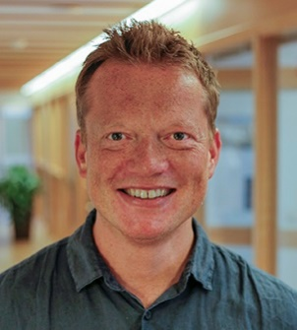
Oslo Medical Corpus

Slide 11
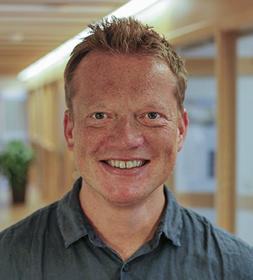
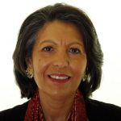
Oslo Medical Corpus
SHE & Genealogies of Knowledge

